Slide 1

Workshop II
Project
Group 13
Yuanhao LI 1830026070
Jianlong LI 1830026061 Mengxian HE 1830026031
Notes:
data process(lyh) -> mapreduce with python(hmx) -> with java(hmx) -> by solr(ljl) -> tf-idf(ljl) -> bonus(ljl)

Slide 2


Contents
1
2
3
Core Code Analysis
&
Result Display
Further
Implementations
Data Collection

Slide 3

Data Collection

Slide 4
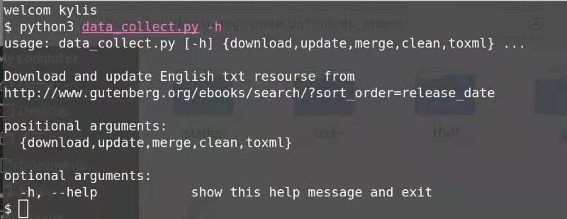
data_collect.py
https://github.com/walkureHHH/juner_1_dp2_porject1
Five functions
download
update
merge
clean
toxml

Slide 5
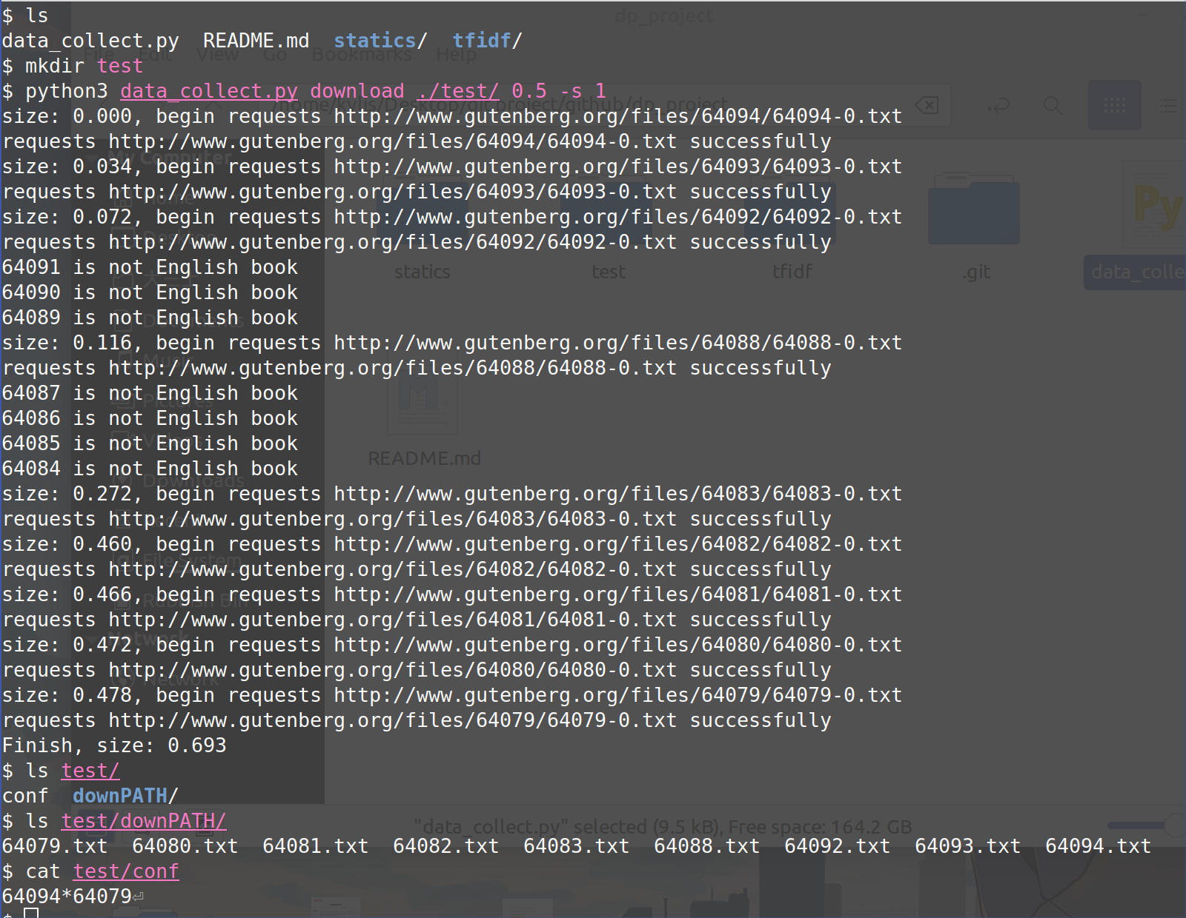
Download Function
Download English-book
run example:

Slide 6
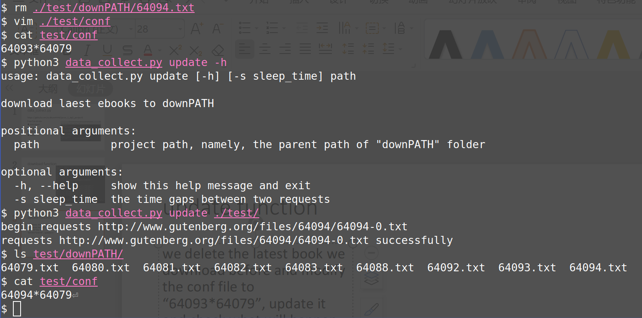
Update Function
We delete the latest book we download before and modify the conf file to “64093*64079”, update it and check what will happen.

Slide 7
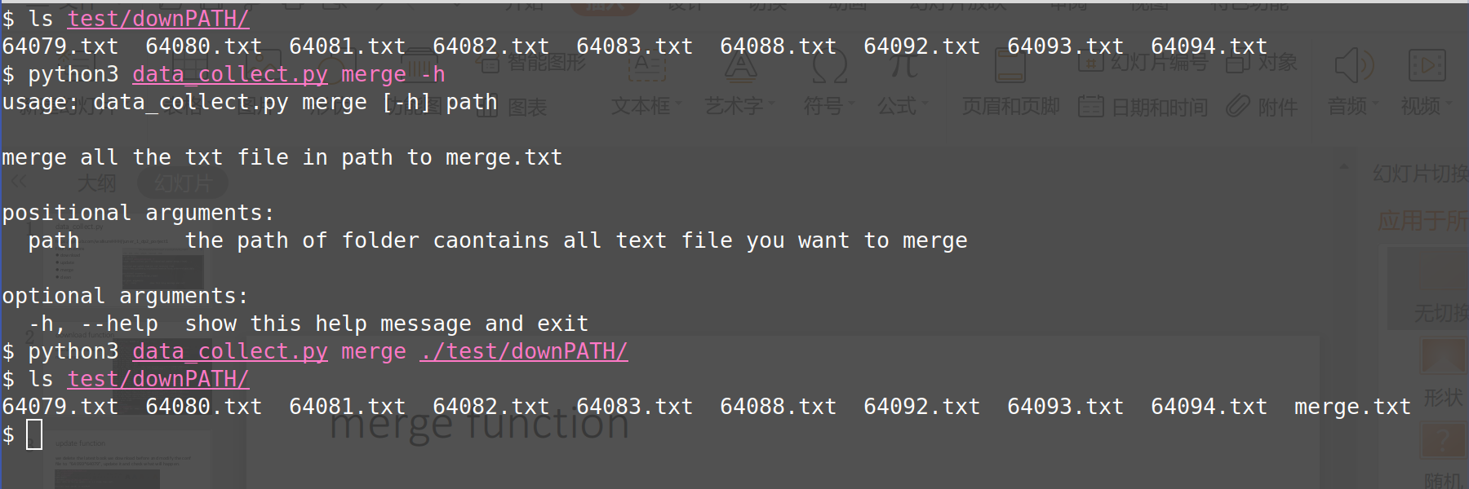
Merge Function
Merge all text files in a folder to merge.txt file

Slide 8
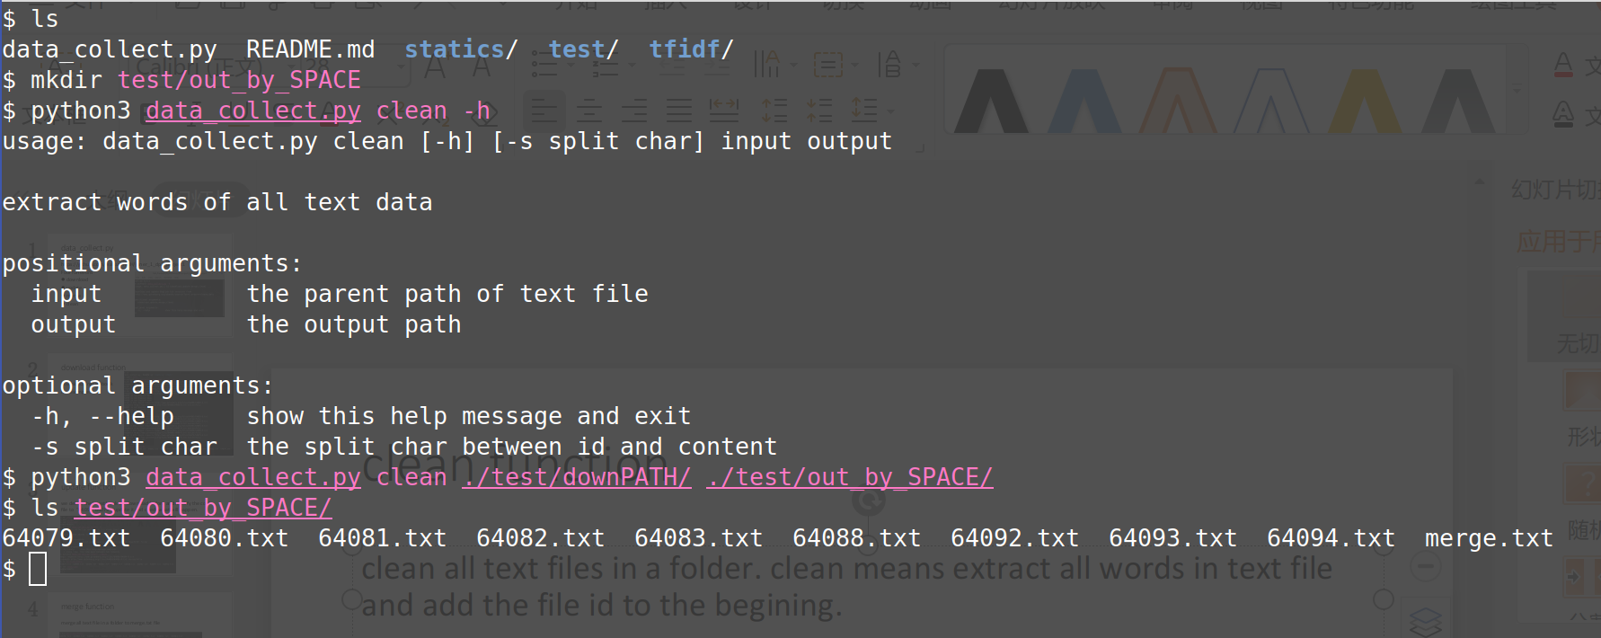
Clean Function
Clean all text files in a folder. clean means extract all words in text file and add the file id to the begining.

Slide 9
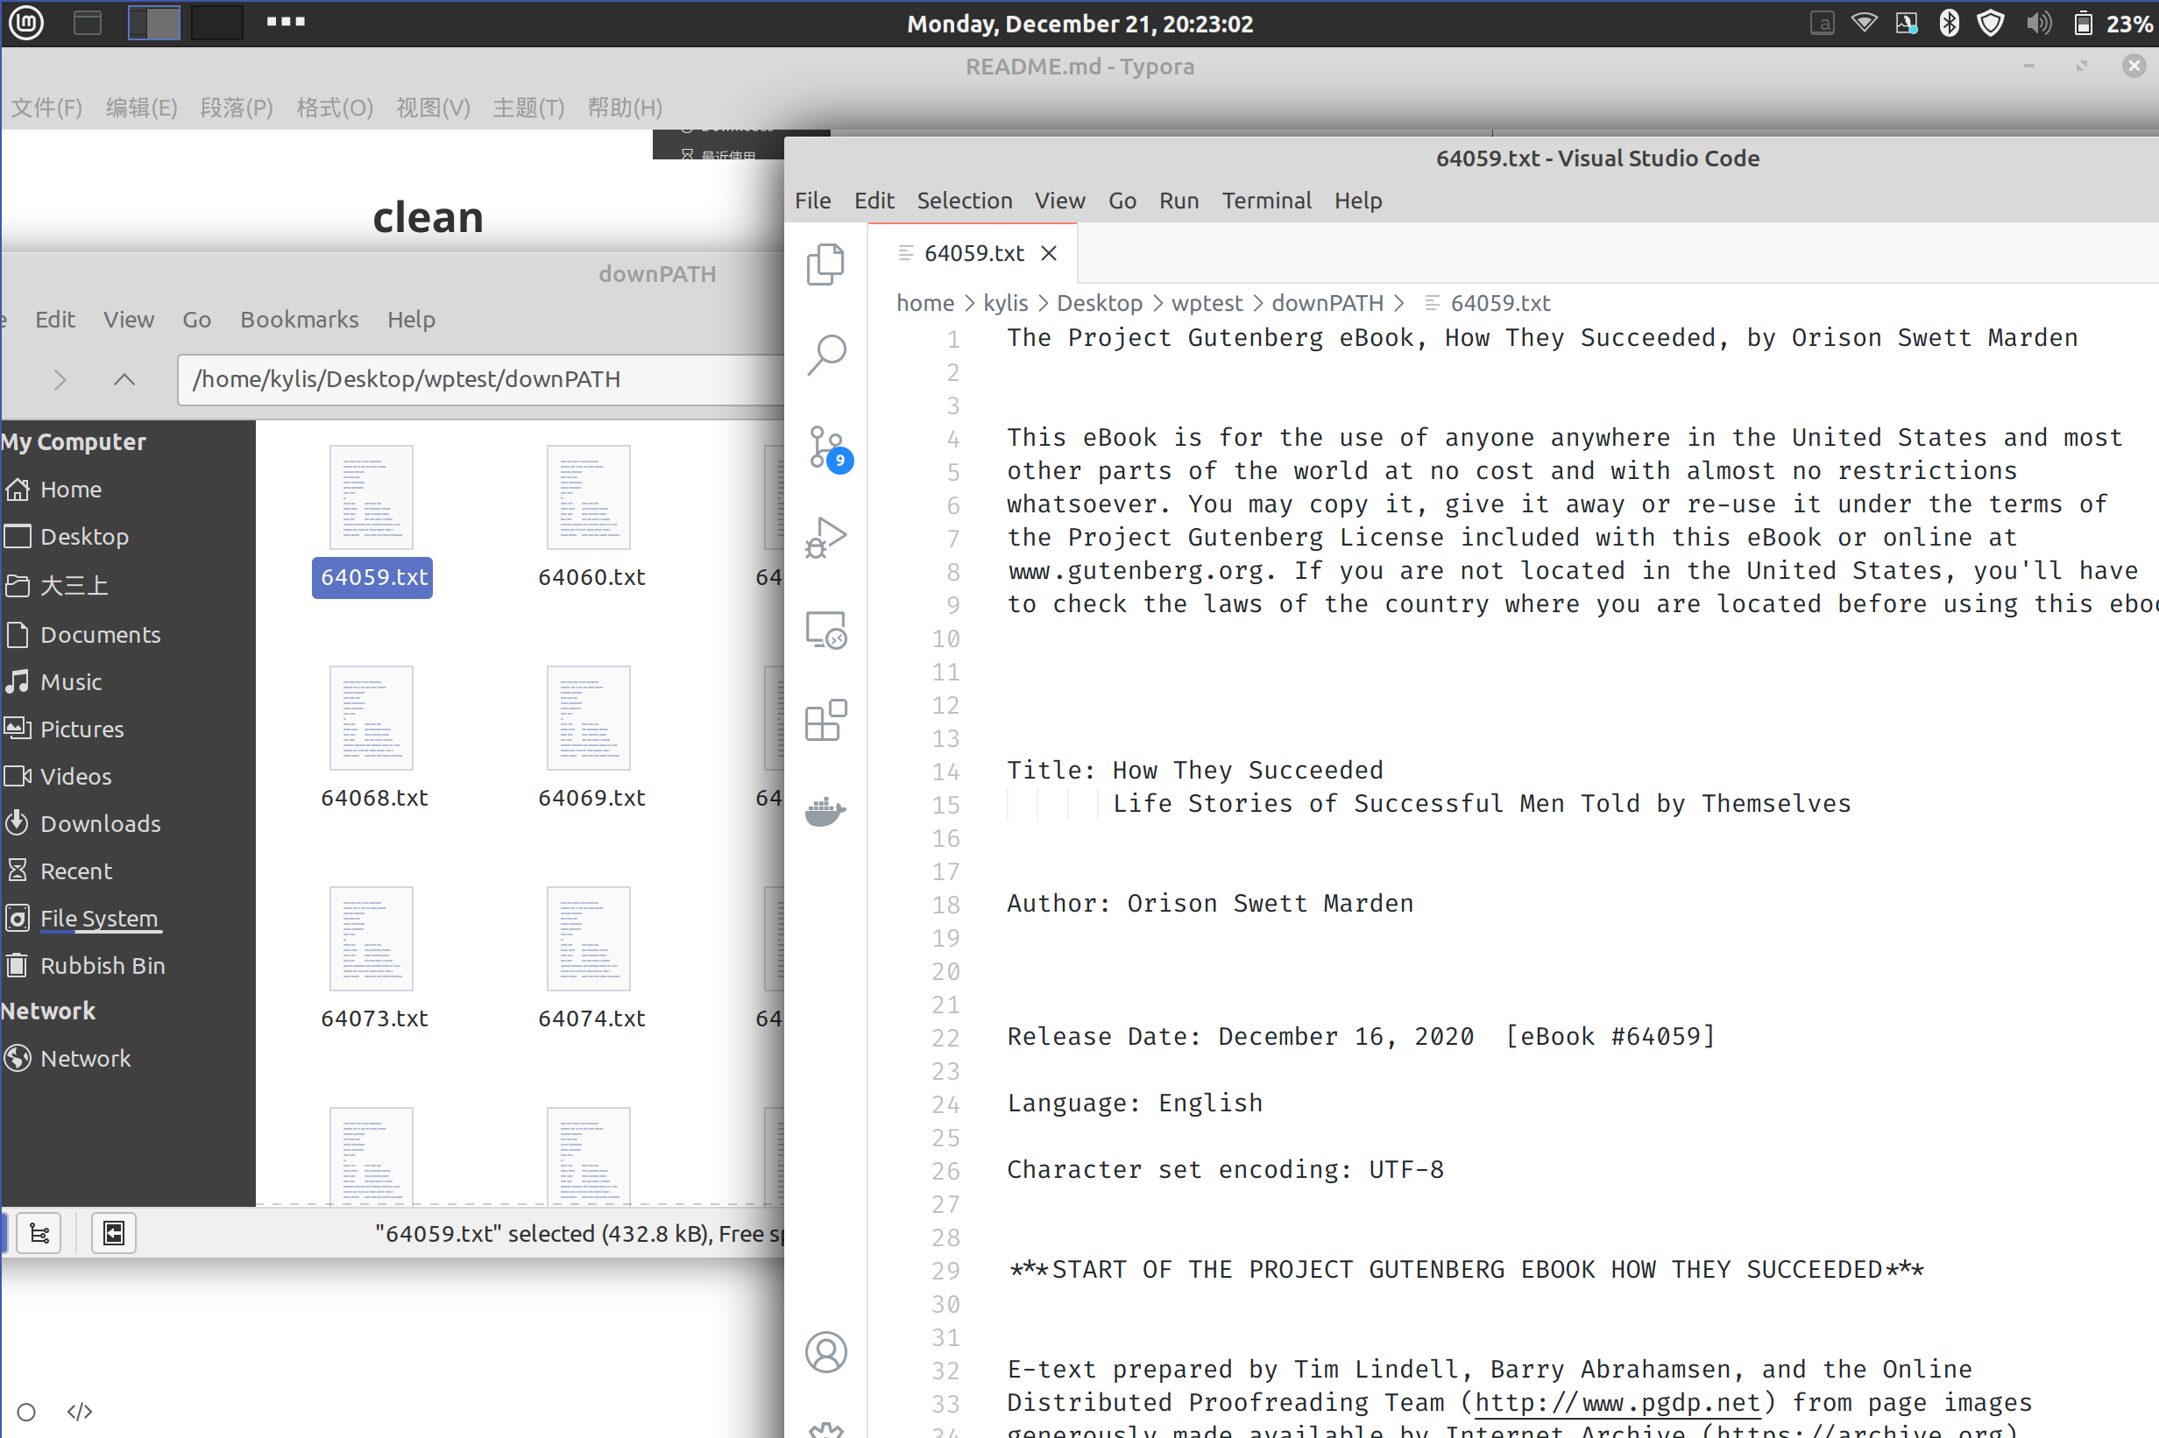
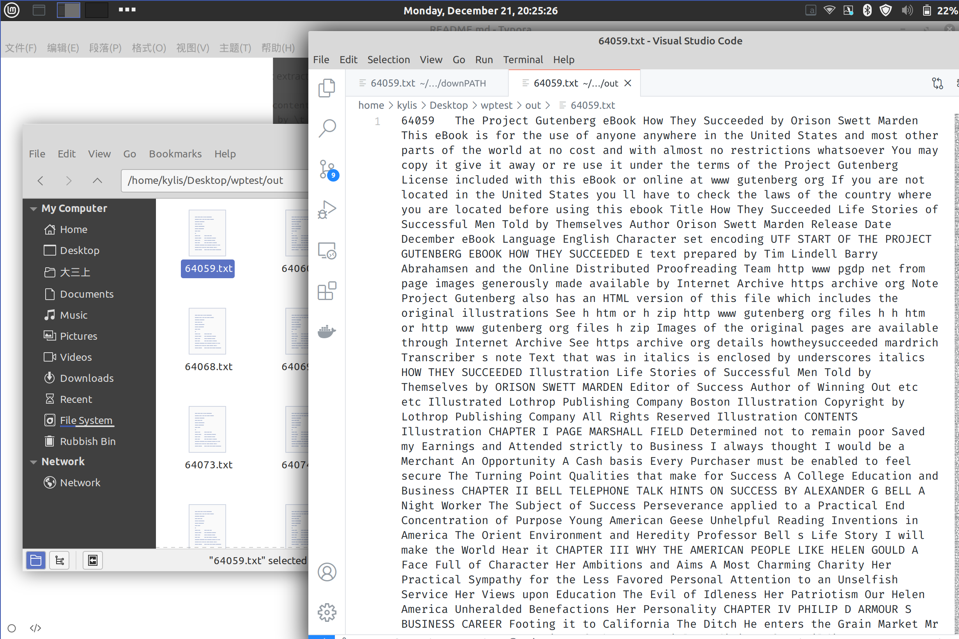
The file before clean:
The file after clean:

Slide 10
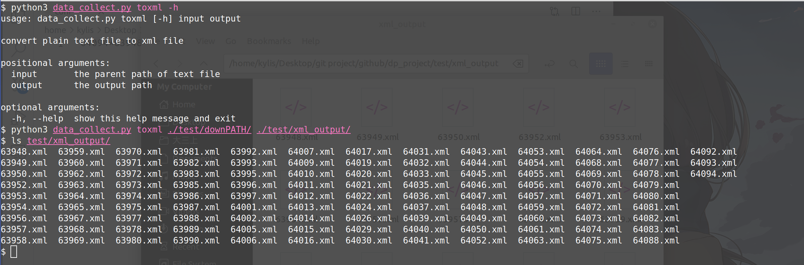
toxml Function
Convert txt. file to xml. file

Slide 11
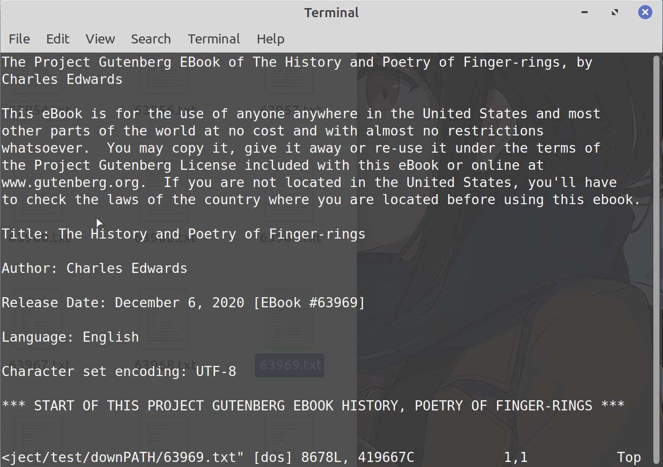
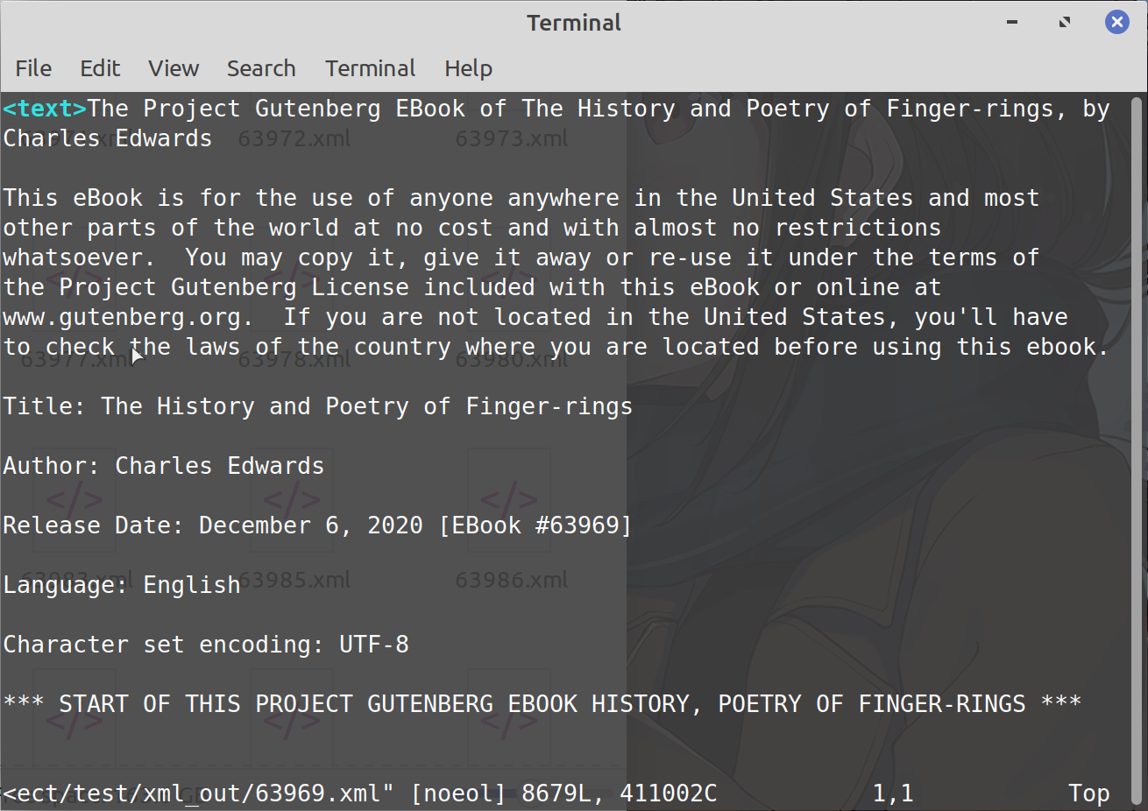
← Before convert
After convert →

Slide 12
Core Code Analysis
& Result Display

Slide 13
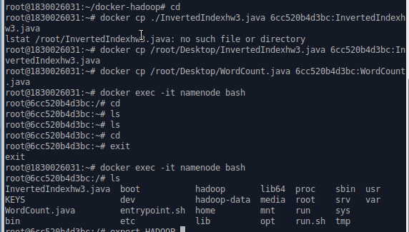
MapReduce with Java
1. Check the container ID and copy the Java file into the container.
Notes:
rank by
merge1.txt: the document that after data merge several files.

Slide 14
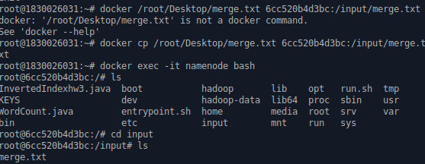
2. Copy the merge.txt into namenode
Notes:
rank by
merge1.txt: the document that after data merge several files.

Slide 15
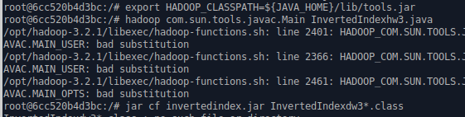
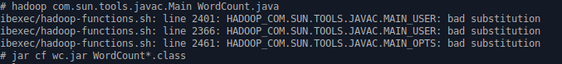
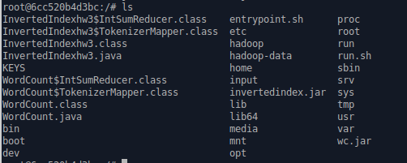
3. Compile the java file into class file
Successfully
compiled

Slide 16
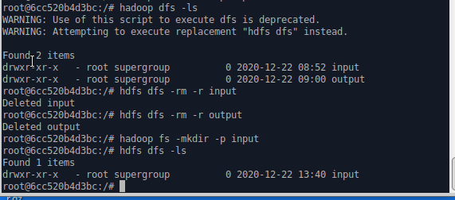
4. Set the path

Slide 17
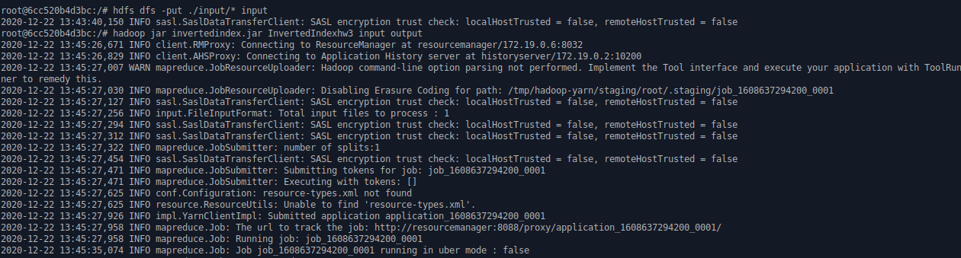
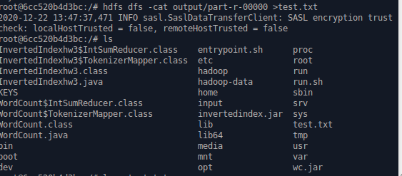
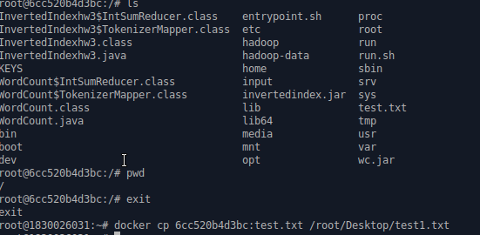
5. Execute
Input:
Output:
as a test.txt

Slide 18
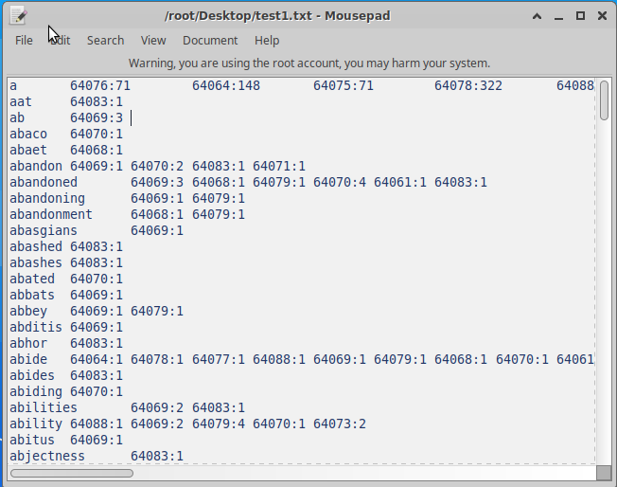

Slide 19
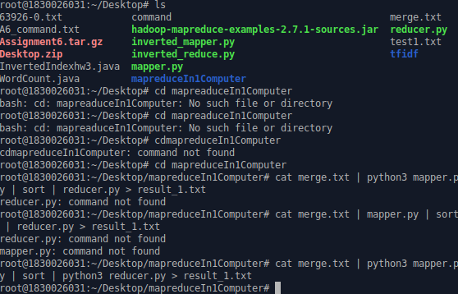
MapReduce by Python

Slide 20
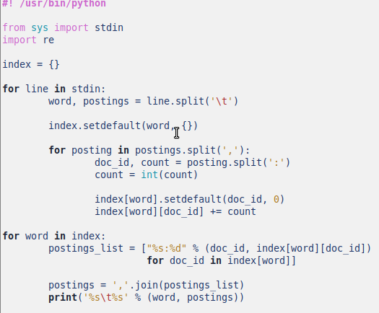
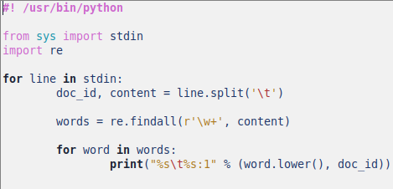
Reduce.py source code
Mapper.py - source code

Slide 21
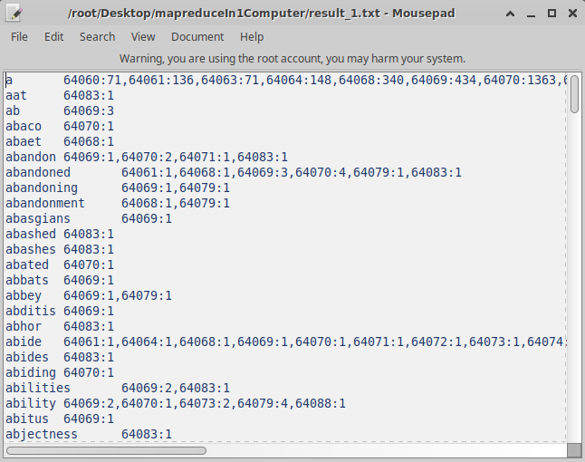
The result was stored as txt.

Slide 22
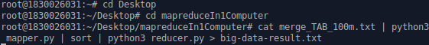
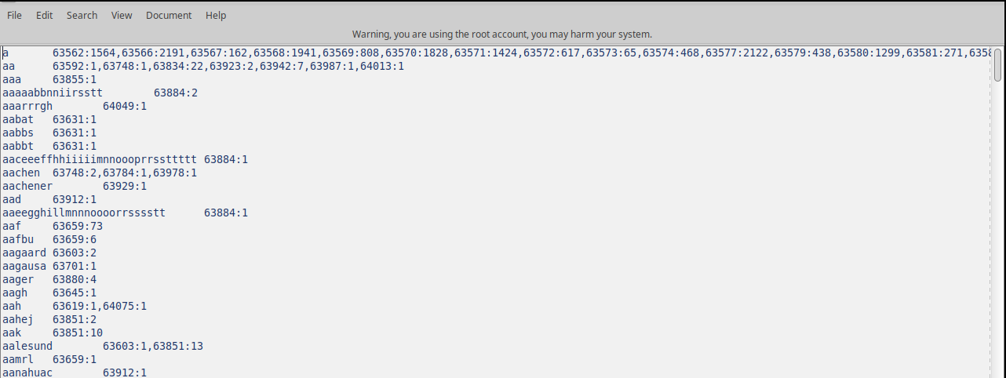
Deal with big data (over 100m)
A little slow (33.2s) ......
But still get the result:

Slide 23
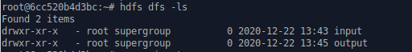
Copy the file in java:
Check the connection path:

Slide 24
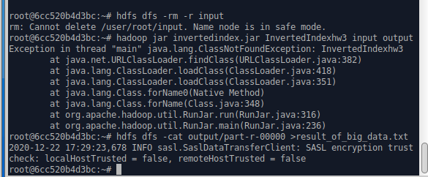
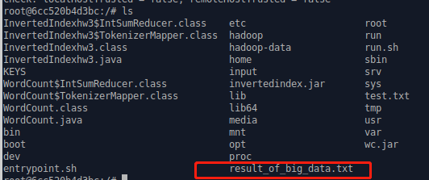
Output as a txt.file named as: result_of_big_data.txt
MapReduce in Hadoop:
Deal with InvertedIndexhw3 with namenode and its three slave:

Slide 25
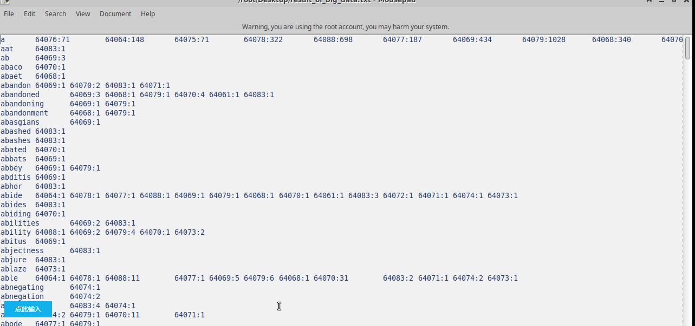
The speed of Hadoop is much faster than the MapReduce by python!
For improve the performance of map and reduce, we decide use solr
and HBase to decrease the search time.

Slide 26
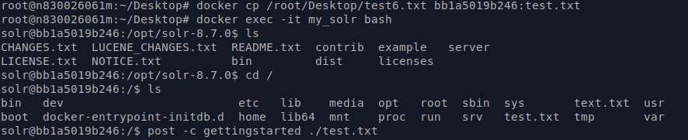
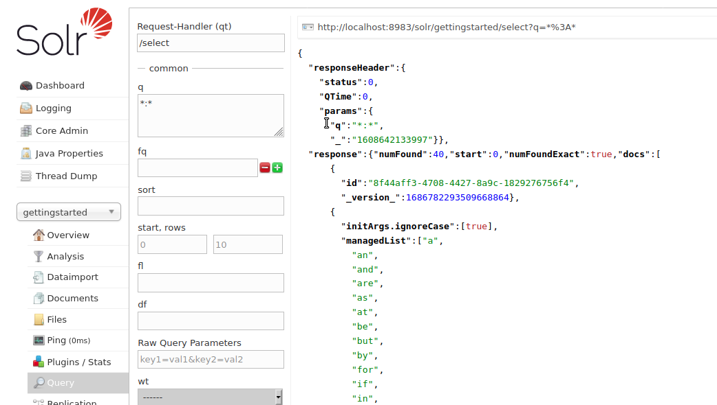
Running in
Solr

Slide 27
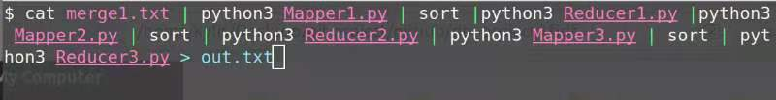
tfidf Hadoop MapReduce

Slide 28
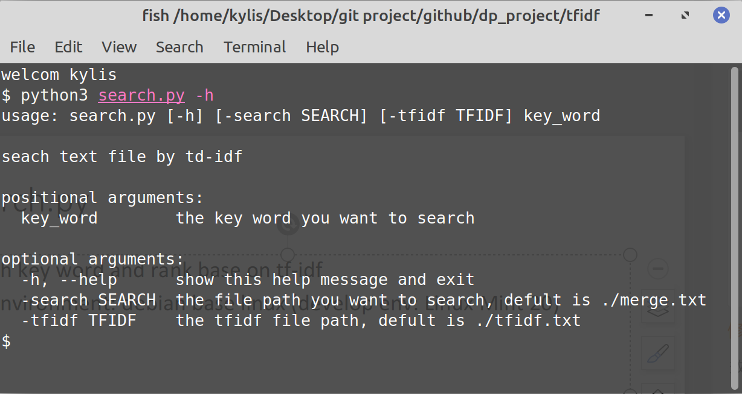
Search.py
Search key word and rank base on tf-idf
Run environment: debian base linux (develop env: Linux Mint 20)

Slide 29
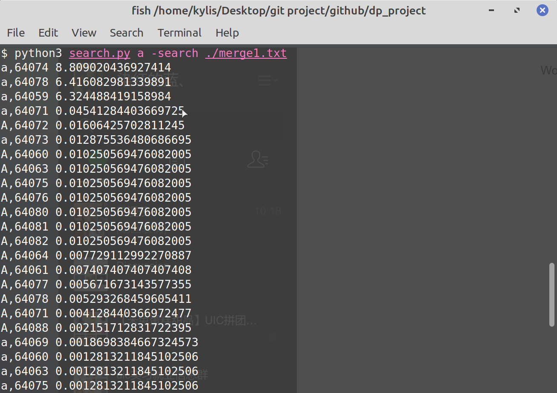
Example:
Search word
“a” in merge1.txt
Notes:
rank by
merge1.txt: the document that after data merge several files.

Slide 30
Further Implementations

Slide 31

THANKs

